Slide 1


Join the
by

Slide 2
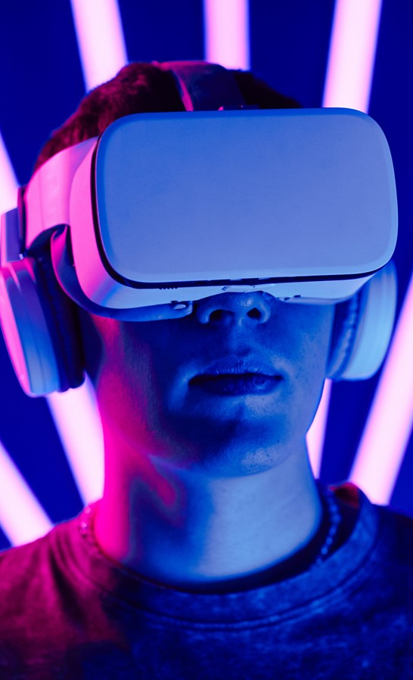



By being a pioneer of new technologies, integrating data into creative thinking and having a multi-touchpoints approach
We position ourselves as an
actor of
INNOVATION
By creating unique partnerships and unexpected alliances, offering effective solutions to our customers, promote openness and new perspectives
EXPLORATION
By introducing positive advertising, encouraging the transition towards a responsible world, objectifying the responsible advertising communication
SUSTAINABILITY

Slide 3
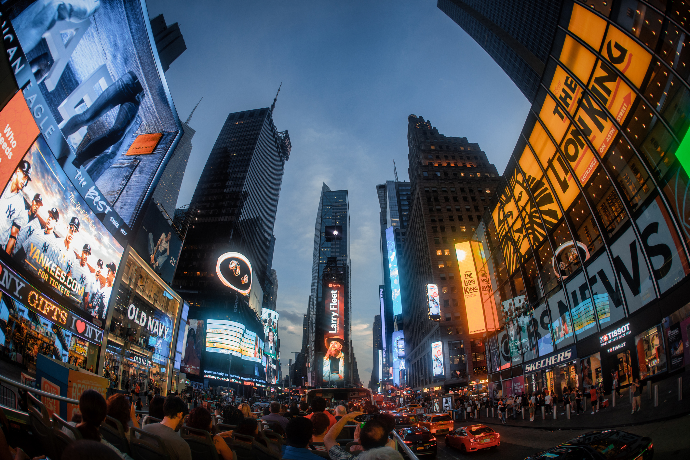
In a world where advertising
can often be seen as
part of the problem

Slide 4



Advertising has a role to play
Motivating changes
in consumer behaviour
Increasing awareness
of responsible consumption

Slide 5
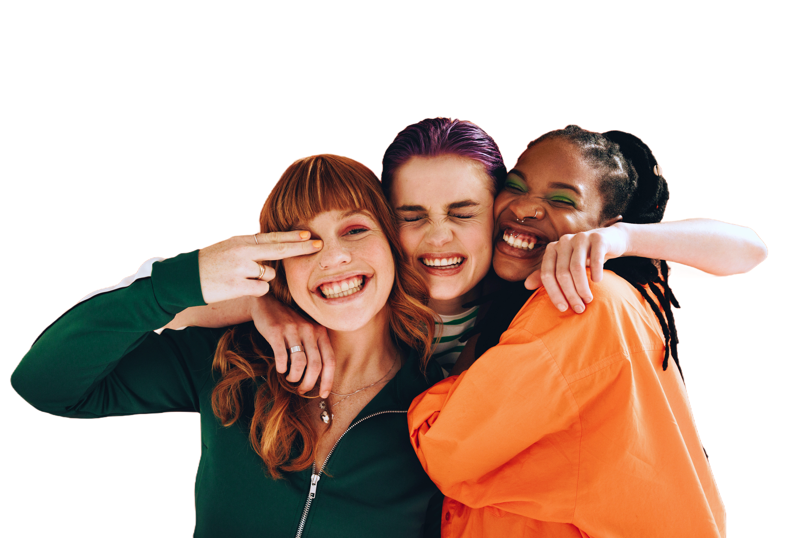
PITCH DAY
  CREATORS
  EDITION

Slide 6


BLUE PITCH DAY
CREATORS EDITION
CONTEXT
RMB aims to offer alternative ways for the various players in the advertising ecosystem to connect. As part of its sustainability vision, RMB will organize the 2nd edition of its Pitch Day in November 2026. This year, RMB and Slice are organizing an exclusive meeting between content creators and advertisers.
IDEA
Launch a call for projects to select 5 concepts committed to sustainability that you, as creators, will pitch directly to brands that want to highlight their responsibility through products/services.
OBJECTIVE
To foster meaningful and long-term business collaborations.

Slide 7
Briefing
CREATORS EDITION
CONCRETE TERMS
Creators will need to submit content that highlights one of the 17 Sustainable Development Goals recognized by the UN: social, environmental, education, health/sports/nutrition, slow fashion, etc., as well as commercial visibility.
DEADLINE FOR THE PROJECT
August 31, 2026 at the latest.
Complete the Project in the further slides.
GLOBAL EVENT
November 19, 2026. With this event, RMB aims to act as an accelerator, enabling content creators to bring their ideas to life while showcasing advertisers.
PROJECT NAME by
CONTENT CREATOR
Pitch and Synopsis
Production Budget
References and Visual Elements
International Examples
Number of Planned Content Items
Distribution Media and Platforms
Project Timeline and Schedule

Slide 8
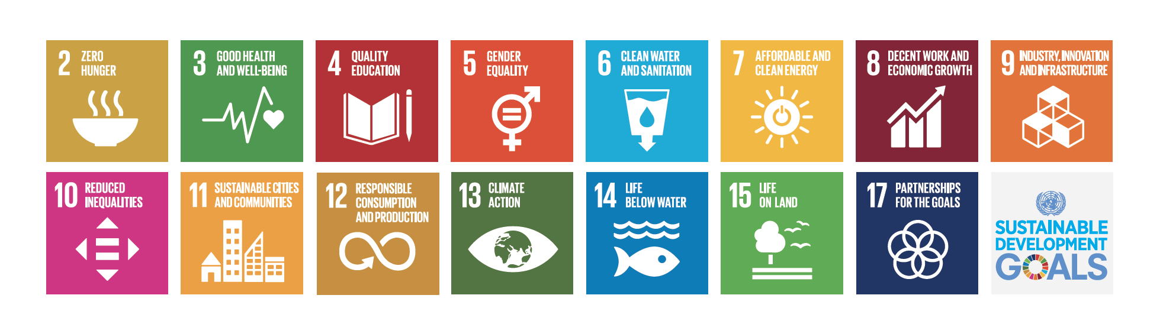
Sustainable Development Goals
CREATORS EDITION
The Sustainable Development Goals (SDGs), established by the United Nations in 2015, are a universal call to action to eradicate poverty, protect the planet, and ensure global prosperity by 2030. Consisting of 17 interconnected goals and 169 specific targets, they balance social, economic, and environmental sustainability.
More information for each SDGs here

Slide 9
Project Name
By
Content Creators Names & Profiles

Slide 10
Project
“xxxxxxx”

Slide 11
Concept
CREATORS EDITION
Infos needed
Your Pitch
Your Concept
Infos & Visuals can be putted here

Slide 12
Insights & Moodboards
CREATORS EDITION
Infos needed
Worldwide inspirations + URL LINKS
Moordboard & Inspiration set-ups

Slide 13
Production Costs
CREATORS EDITION
Fill-in the table (not every line if not necessay)
Pre-Production | Price unit | Number of Days | x € | Comments
Preparation | x € |  | x €
Copy Writing | x € |  | x €
Graphism | x € |  | x €
Production | Price unit | Number of Days | x € | Comments
Video Producer | x € |  | x €
Video Framer | x € |  | x €
Sound Engineer | x € |  | x €
Make Up artist | x € |  | x €
Photographer | x € |  | x €
Product Assistant | x € |  | x €
Production insurances | x € |  | x €
Post Production | Price unit | Number of Days | x € | Comments
Format 9/16 Video | 700 € |  | 3.500 €
Format 16/9 Video | 1.700 € |  | 1.700 €
Format mp3 or wav | 250 € |  | 250 €
Social Visuals | 700 € |  | 700 €
TOTAL |  |  | x €

Slide 14
Content strategy
& Timeline

Slide 15
Content strategy
CREATORS EDITION
Infos needed
Your Main content platform
Your Promotion platforms
Where do you associate a sustainable brand

Slide 16



Content strategy (Promotion)
CREATORS EDITION
Broadcast
DAY – Hour - Period
Youtube
1 Youtube long Format
Xxxx Average Video Views estimated
Instagram
Instagram Reels (teasers)
Instagram Stories (best-off)
Xxxx Average Video Views estimated
Xxxx Average Impressions estimated
TikTok
Tik Tok Videos (teasers)
Xxxx Average Video Views estimated

Slide 17
Timeline & Retroplanning
CREATORS EDITION
Infos needed
Production start
Promotion start
Publication start

Slide 18
Timeline & Retroplanning
CREATORS EDITION
JUNE
JULY
AUGUSTUS
SEPTEMBER
OCTOBER
NOVEMBER
DECEMBER
PROJECTS CONSTRUCTION
DEADLINE : 31/08
19/11
GLOBAL PITCH EVENT
2026
JANUARY
FBRUARY
MARCH
APRIL
MAY
JUNE
JULY
PRODUCTION
2027
PROMOTION
PUBLICATION

